Slide 1


BOSTON UNIVERSITY BA476 SPRING 2024
Spotify Top Hits Popularity Predictor
Group 3: Cecily Wang, Emily Doherty, Axel Bautista-Tienda, Hanchao Tang, Sean Ryan

Slide 2

Why is this important and relevant?
Statement of the Problem
help increase the generation of sales which play a high value when it comes to streaming platforms.
help music artists to reach a wider audience.
Can we accurately predict the popularity of a song based on selected features?
Objective
Initially, the features that we thought would be the best indicators for how popular a song would be were: danceability, mode, valence, instrumentalness, and tempo.
Develop a model that lowers MSE the most so that we can accurately predict popularity.

Slide 3

This dataset covers the top 2000 tracks on Spotify from 2000-2019. It is originally sourced with Spotify library for Python.
About our data
Contents of the Data
Understanding and Appropriateness of the Data
Contains categorical and numerical data spanning artist names, track titles, release years, and various measures of track characteristics (like danceability, energy, and loudness).
The entire dataset consists of 18 features and has over 2000 instances.
The purpose of this dataset is to analyze trends in music over the years 2000-2019 and understand what influences track popularity. This helps us train our ML algorithms to reach our problem goal.
This dataset is appropriate for the issue we want to solve because of how comprehensive it is in terms of the variety of features and the span of years which makes it suitable for the analysis of trends in musical attributes and popularity.

Slide 4
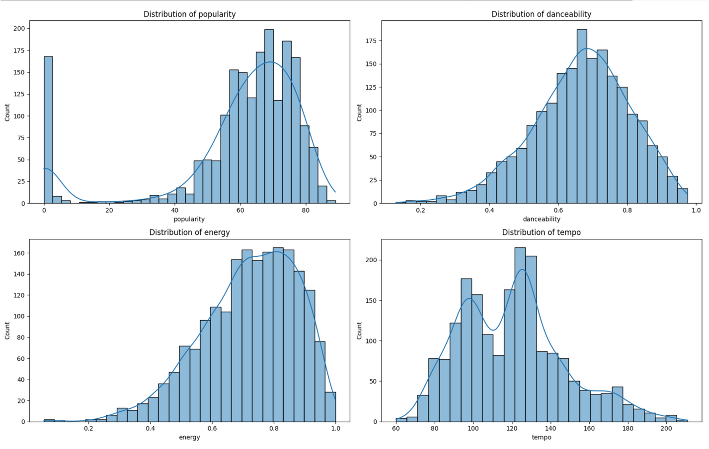
Basic Descriptive Visuals

Slide 5

Spotify Data from Kaggle
Workflow
Data Cleaning
Feature Engineering
Train Models
Test MSE
Tune Models (Grid Search)
Cross Validate
Cross Validate

Slide 6
Handling the Data
Data Cleaning and Feature Engineering
Missing Values | For features where missing values were significant (e.g., genre), decisions needed to be made whether to fill these in based on external sources or to remove entries.
Normalization/Standardization | Features like loudness and tempo have been standardized to ensure comparability across different recordings.
One hot Encoding Categorical Data | Transforming categorical data such as artist names and genres into a usable format for our machine learning models.
Feature Creation | 'artist_popularity' column reflects the average popularity of songs by the same artist. ‘age_of_song’. interaction term: tempo * valence.

Slide 7
Machine Learning Techniques
ML Techniques Linear Regression Principal Component Analysis (PCA) Polynomial Regression Lasso and Ridge Regression Decision Trees and Random Forests Elastic Net Boosting and Bagging | Primary methods that we used to navigate and refine these models were: Cross Validation (k-fold, nested) Grid Search Cross Validation Mean Squared Error and Adjusted R^2. (Used to evaluate model performance) One hot encoding Standardization of data/features Feature engineering

Slide 8
Model Outcomes

Slide 9
Model | MSE | Adjusted R^2 | RMSE | Best alpha | Features chosen
BASELINE: Model: Linear Regression | 511.00060515841136 |  |  |  | 'danceability', 'mode', 'valence', 'instrumentalness', 'tempo'
Linear Regression WITH Principal Component Analysis (data is standardized) | 263.69549660799527 | 0.4751208622199029 |  |  | 68 PCA components
Ridge Regression Model (with one hot encoded, feature engineered columns, and ALL data columns) | 242.3266399 | 0.5176550247245986 | 15.566844248640606
Ridge Regression With Cross validation |  | 0.5237442580550712
Linear Regression; with our one hot encoded elements and feature engineered columns and ALL data columns | 242.96681067162064 | 0.5163807811095031
Ridge Regression;After parameter tuning, standardization, grid search cv. with our one hot encoded elements and feature engineered columns and ALL data columns | 242.84053015839808 |  |  | 100
Linear Regression(using lassocv to find best features and cv score and alpha). with our one hot encoded elements and feature engineered columns and ALL data columns | artist_popularity: 235.68767684343914 duration_ms: 504.6027514425772 |  |  |  | LassoCV gave us features: ‘Artist_popularity’, ‘duration_ms’
Lasso Regularization on all necessary features (onehot, feature eng cols)Data is standardized and cross validated, | 235.78458554155938 | 0.5306768164309301 | 0.1 | 1
ElasticNet w/ GridSearchCV | 239.32686256709115 | 0.5166321392394344 | 15.583341431105143 | 0.1 | one hot encoded features, the original float features, and the new features (artist_popularity, age_of_song)
Lasso w/ Polynomial Features, degree chosen using GridSearchCV | 238.95954816774116 | 0.5243571345738232 | 15.458316472622146 | 1 | one hot encoded features, the original float features, and the new features

Slide 10
Model | MSE | Adjusted R^2 | RMSE | Best alpha | Features chosen
Decision Tree With Pruning | 0.43 | -0.88 |  |  | ‘danceability', 'mode', 'valence', 'instrumentalness', 'tempo'
Decision Tree With Recursive Feature Elimination | 0.37 | -0.63 |  |  | 'energy', 'loudness', 'speechiness', 'acousticness', 'liveness'
Bagging w/ GridSearchCV | 340.4853 | 0.25 | 19.3736
Boosting w/ GridSearchCV | 245.6471 | 0.49 | 15.9913
Random Forest | 15.4 | 0.99 |  |  | "duration_ms", "danceability", "energy", "key", "speechiness", "acousticness", "instrumentalness", "liveness", "valence", "tempo", "artist_popularity", "age_of_song", "explicit_True"

Slide 11
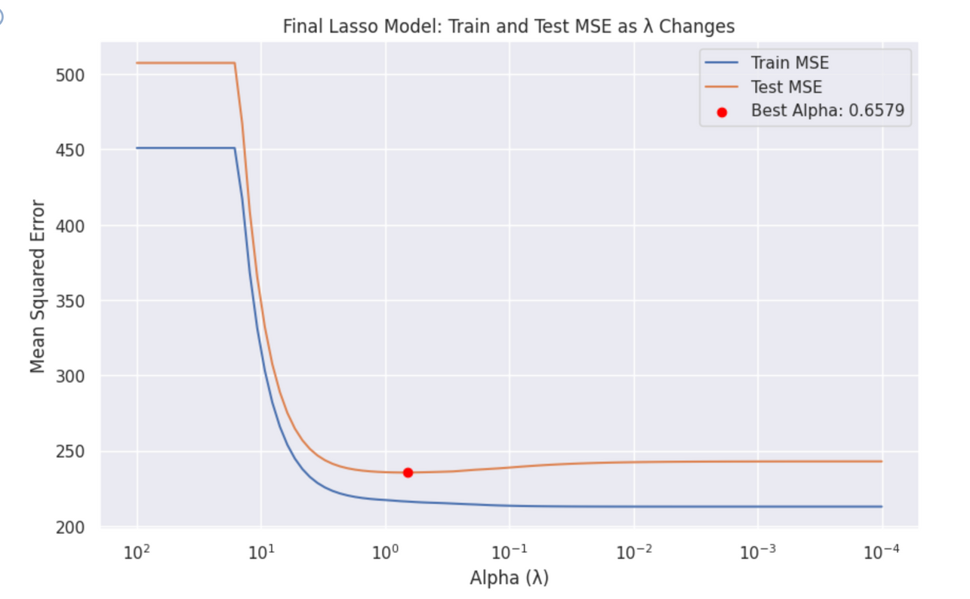
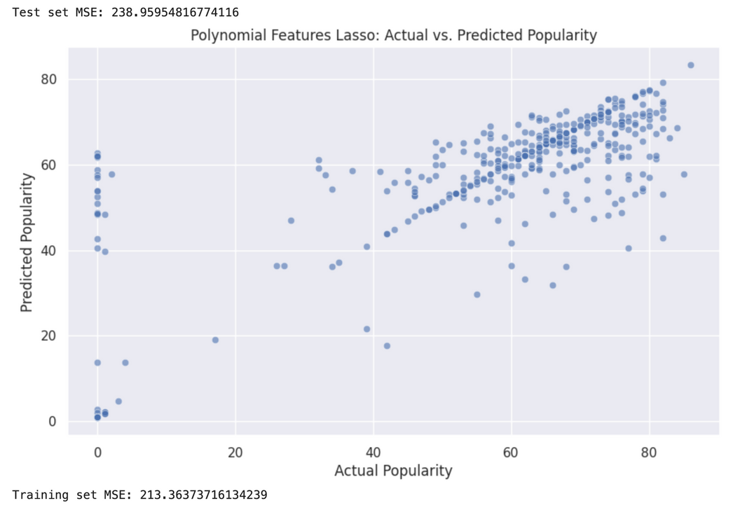
The Final Lasso Regularization Model that gave us one of our best MSE at 236
The Final Polynomial Lasso also gave a competitive test MSE of 239.
Feature selection: shrink less important feature's coefficients to zero,
Prevent overfitting by reducing model complexity

Slide 12
When we changed our approach to classification:
The Final Decision Tree With Recursive Feature Elimination Model gave us our lowest MSE at 0.37

Slide 13
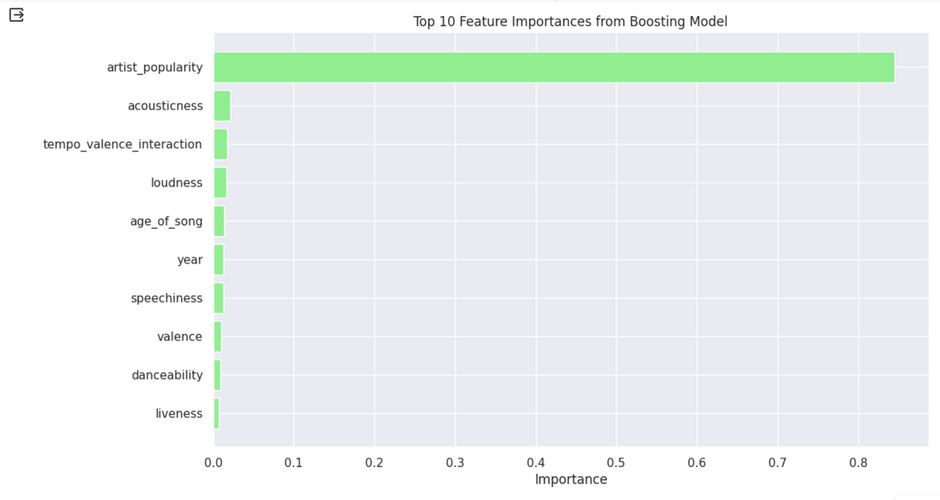
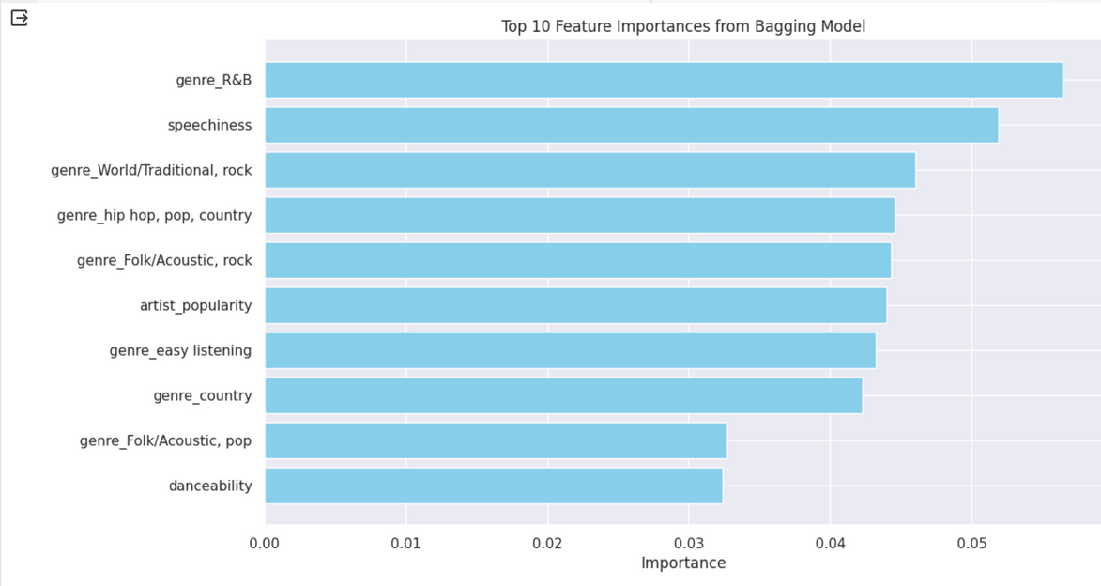
Bagging/Boosting Feature Importance
The boosting model prioritizes artist popularity and acoustic properties, while the bagging model emphasizes genres and vocal content in predicting song popularity.

Slide 14
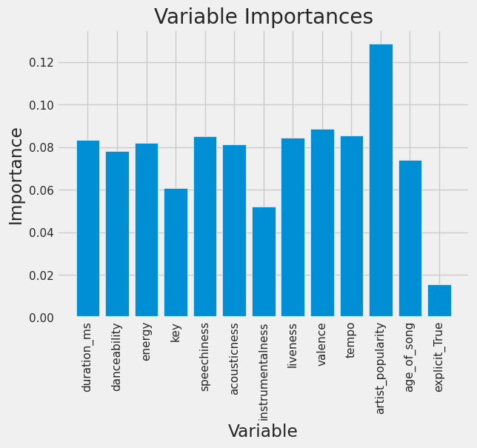
Random Forest Feature Importance
Artist_Popularity (a measure of how many popular songs an artist has) had the strongest importance in predicting whether a song would have greater popularity of 0.13
Following variables were speechiness, valence, and tempo at 0.09

Slide 15
Challenges and Overcomings
Faced high runtime and so we were limited in how much we could tune our models using cross-validation and GridSearchCV based on hardware constraints and time
Another challenge - data was perhaps not suitable for linear regression.
Best models up to that point were linear regression, but still not capturing a large proportion of the data.
We performed feature engineering on our response feature
Found greater success treating this as a classification problem - response predictor of 1 or 0 depending on a threshold of popularity - rather than regression
Through this project, we learned that there is a great deal of creativity and trial and error that goes into choosing and tuning a great ML model

Slide 16
THANK YOU

